Slide 1

Algorithm Analysis IT-2101
Dr. Mohammad Abu Yousuf
yousuf@juniv.edu

Slide 2
Quicksort

Slide 3
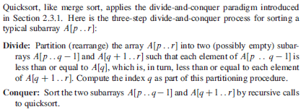

Slide 4
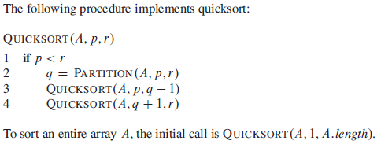
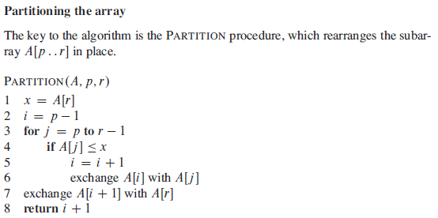

Slide 5
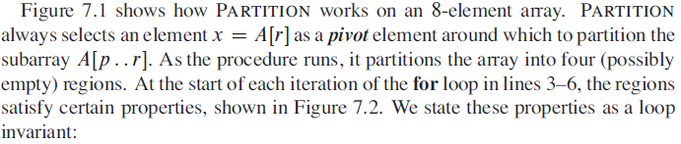
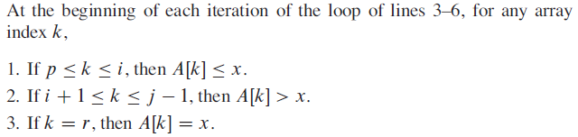

Slide 6
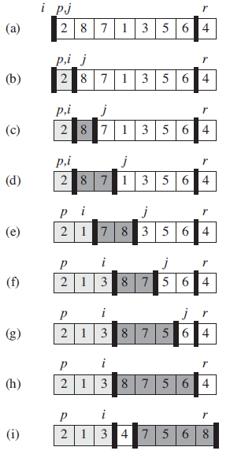
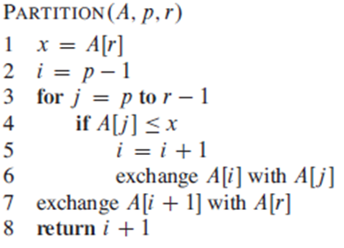

Slide 7
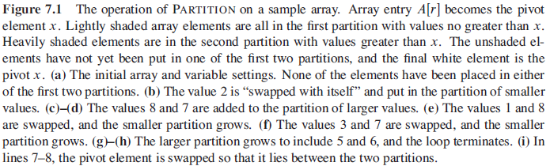
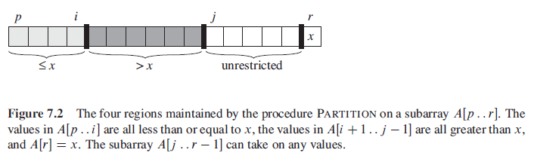

Slide 8
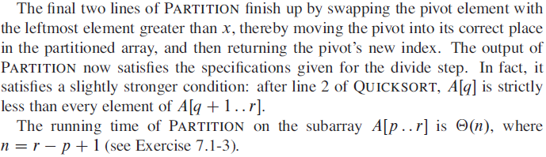
Running Time

Slide 9
Performance of quicksort
The running time of quicksort depends on whether the partitioning is balanced or unbalanced, which in turn depends on which elements are used for partitioning.
If the partitioning is balanced, the algorithm runs asymptotically as fast as merge sort.
If the partitioning is unbalanced, however, it can run asymptotically as slowly as insertion sort.
Here, we shall informally investigate how quicksort performs under the assumptions of balanced versus unbalanced partitioning.

Slide 10
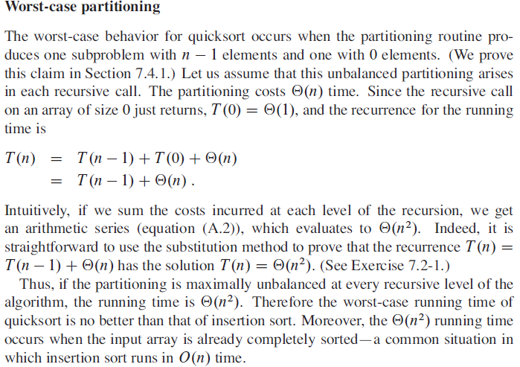

Slide 11
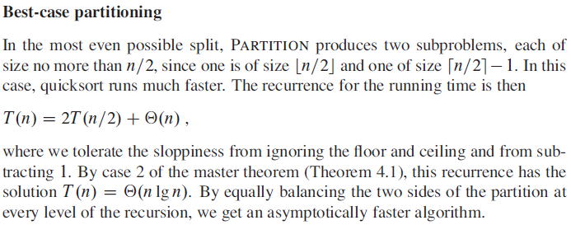

Slide 12
Thank you

